Slide 1

Cloud Computing

Slide 2
Cloud models :
2.1 Cloud characteristics,
2.2 Measured Service,
2.3 Cloud models,
2.4 Security in a public cloud,
2.5 Public versus private clouds,
2.6 Cloud infrastructure self service.

Slide 3
2.1 Cloud Characteristics
The following characteristics set apart cloud from other computing techniques:
On-Demand Service - without requiring human interaction with service provider
Ubiquitous Network Access - access from any device
Location -Independent Resource Pooling : No control, knowledge over physical location of server
Rapid Elasticity - scale -out and scale-in, automatically & rapidly

Slide 4

2.1 Introduction
Cloud computing is an emerging style of computing where applications, data and resources are provided to users as services over the web.

Slide 5
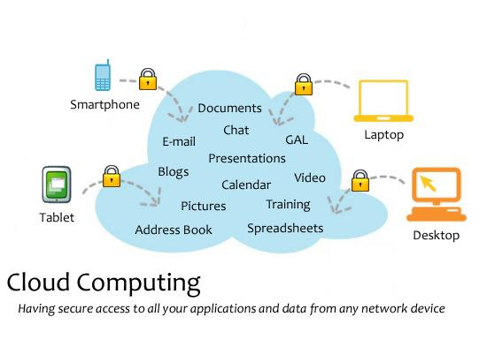
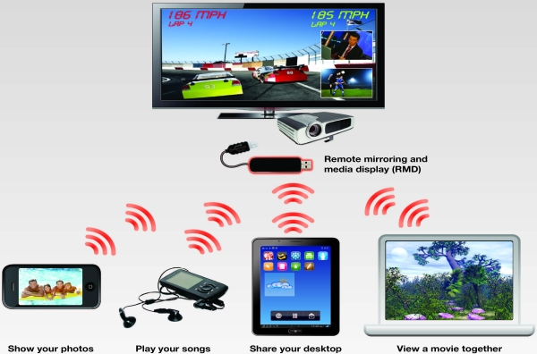
2.1 Introduction
The services provided by cloud may be available
globally,
always on,
low in cost,
on-demand,
massively scalable,
'pay as you grow'.

Slide 6

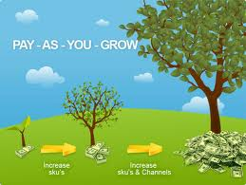
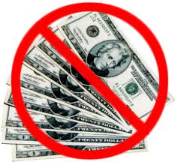
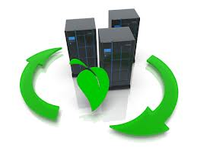

services provided by clservices provided by cloudoud

Slide 7
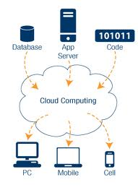
Introduction
Cloud computing is a model-driven methodology that provides configurable computing resources such as services, networks, storage and applications as and when required with minimum efforts over the Internet services.

Slide 8
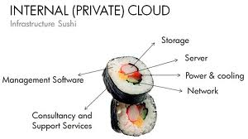
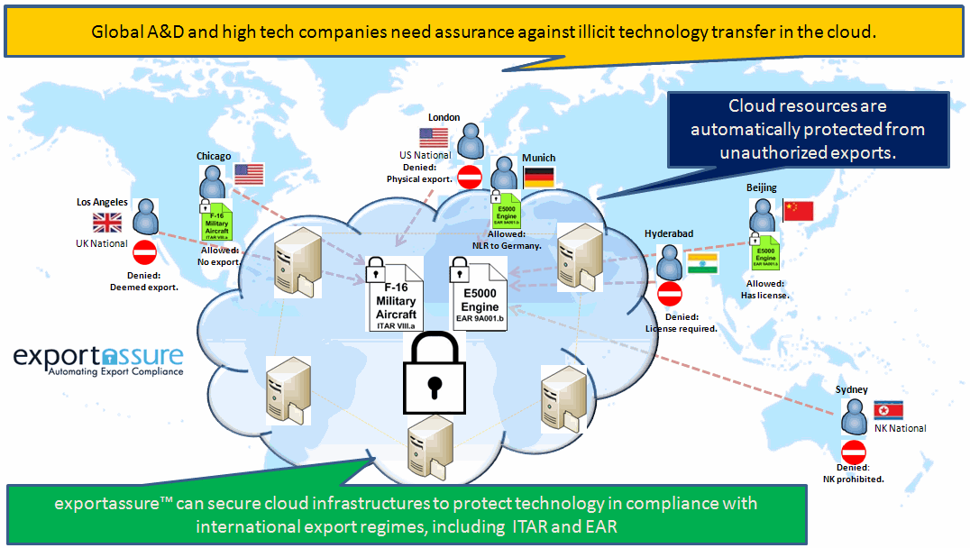
This chapter describes several models for cloud computing: PRIVATE (deployment within firewall),
PUBLIC (where application services outside firewall)

Slide 9
2.2 Cloud Characteristics
Cloud carries the basic infrastructure characteristics that are helpful to deploy cloud service in a fast and cost-effective manner.
The following characteristics set apart cloud from other computing techniques:
On-Demand Service
Ubiquitous Network Access
Location Independent Resource Pooling
Rapid Elasticity
Measured Service

Slide 10
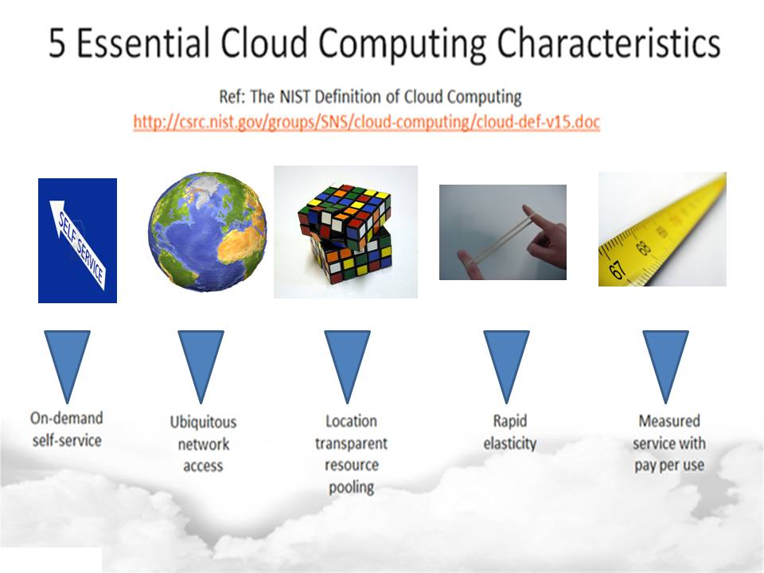

Slide 11
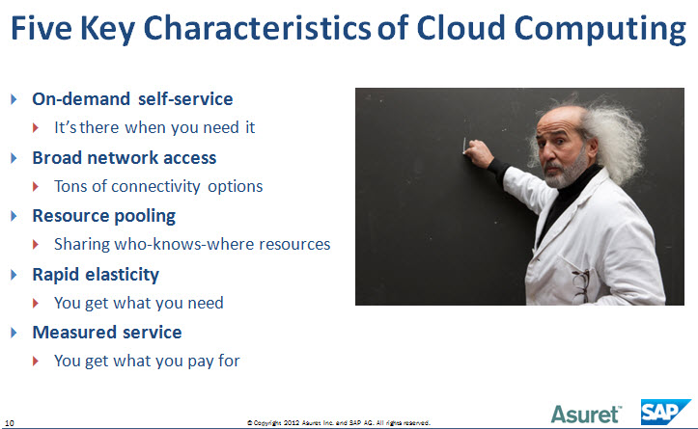

Slide 12
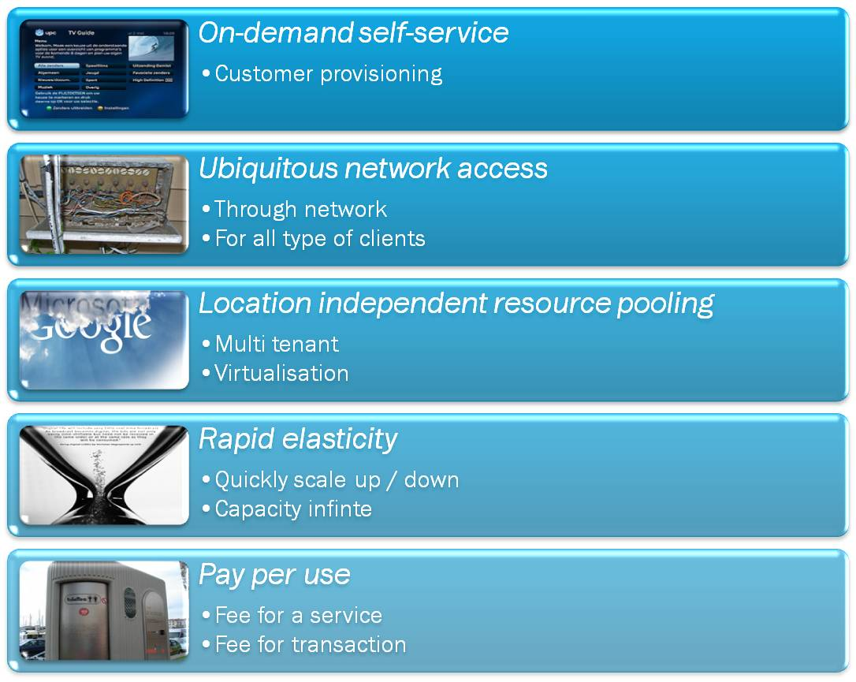

Slide 13
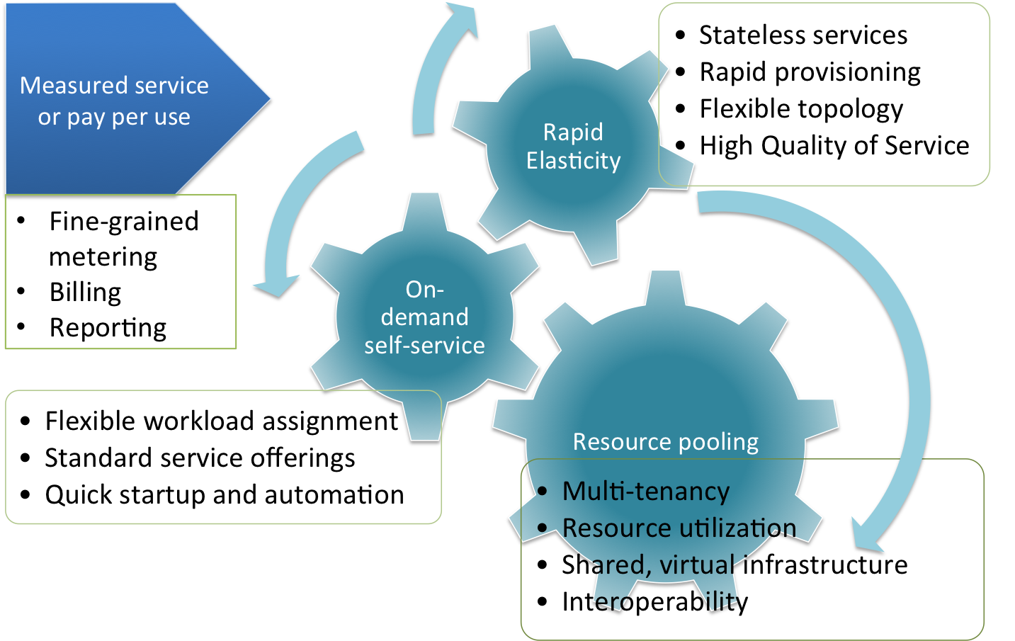

Slide 14
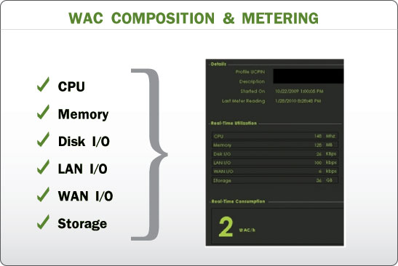
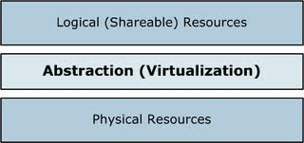
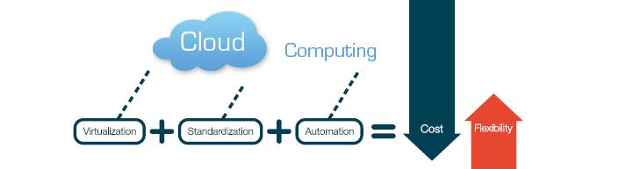
2.2 Measured Service
Cloud Systems automatically control and optimize resource use by leveraging a metering capability at some level of abstraction appropriate to the type of service (storage, processing, bandwidth....)
Standardization and virtualization are the key to reduce infrastructure costs while still meeting the dynamic needs of the business.

Slide 15
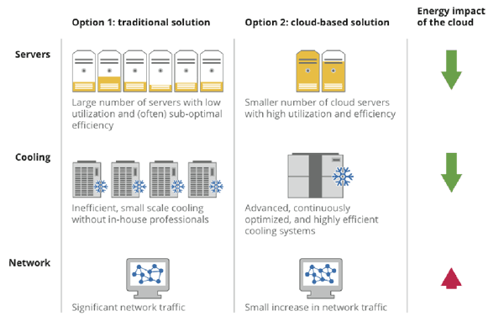
Computing - Traditional Vs Cloud

Slide 16
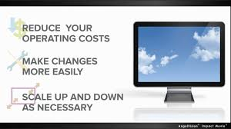

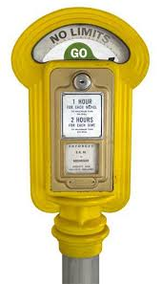
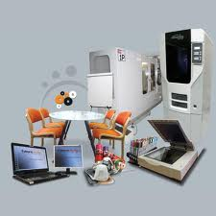
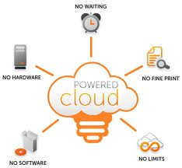
Why organizations taking action now to migrate to cloud computing ? pg 22
To derive greatest flexibility and reduce cost
To avoid vulnerability to costly problems and delays arising from trial-and-error method of migrating workload (live migration)
To augment limited in-house resource or experience

Slide 17
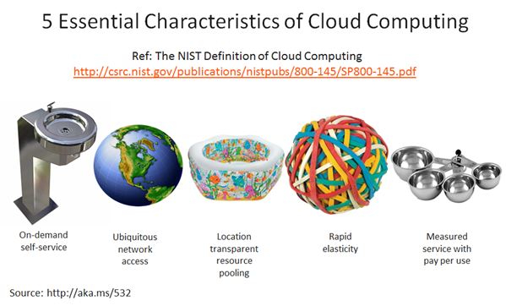
Cloud Computing - Essential Characteristics

Slide 18
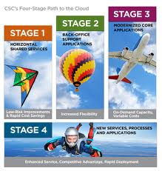

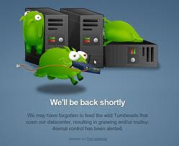

Cloud vendors can address client's challenges by:
Prioritizing workloads based on business impact and risk
Maximising business return by identifying applications that are well suited for cloud computing and have high business impact
Addressing problematic workloads

Slide 19


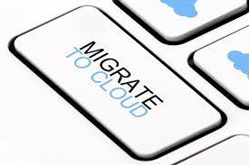
Cloud vendors can address client's challenges by:
Helping avoid costly implementation issues by identifying potential difficulties during migration
Mitigating risk of costly implementation delays by identifying potential problems and addressing them before migration
Avoiding inadequate performance of highly complex and integrated workload

Slide 20


Cloud vendors can address client's challenges by: -cntd
Leveraging expertise to deliver an actionable roadmap to successfully migrate applications to cloud environment
Accelerating your cloud initiatives

Slide 21
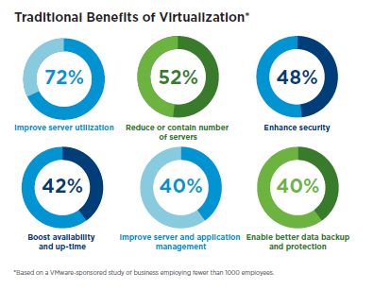
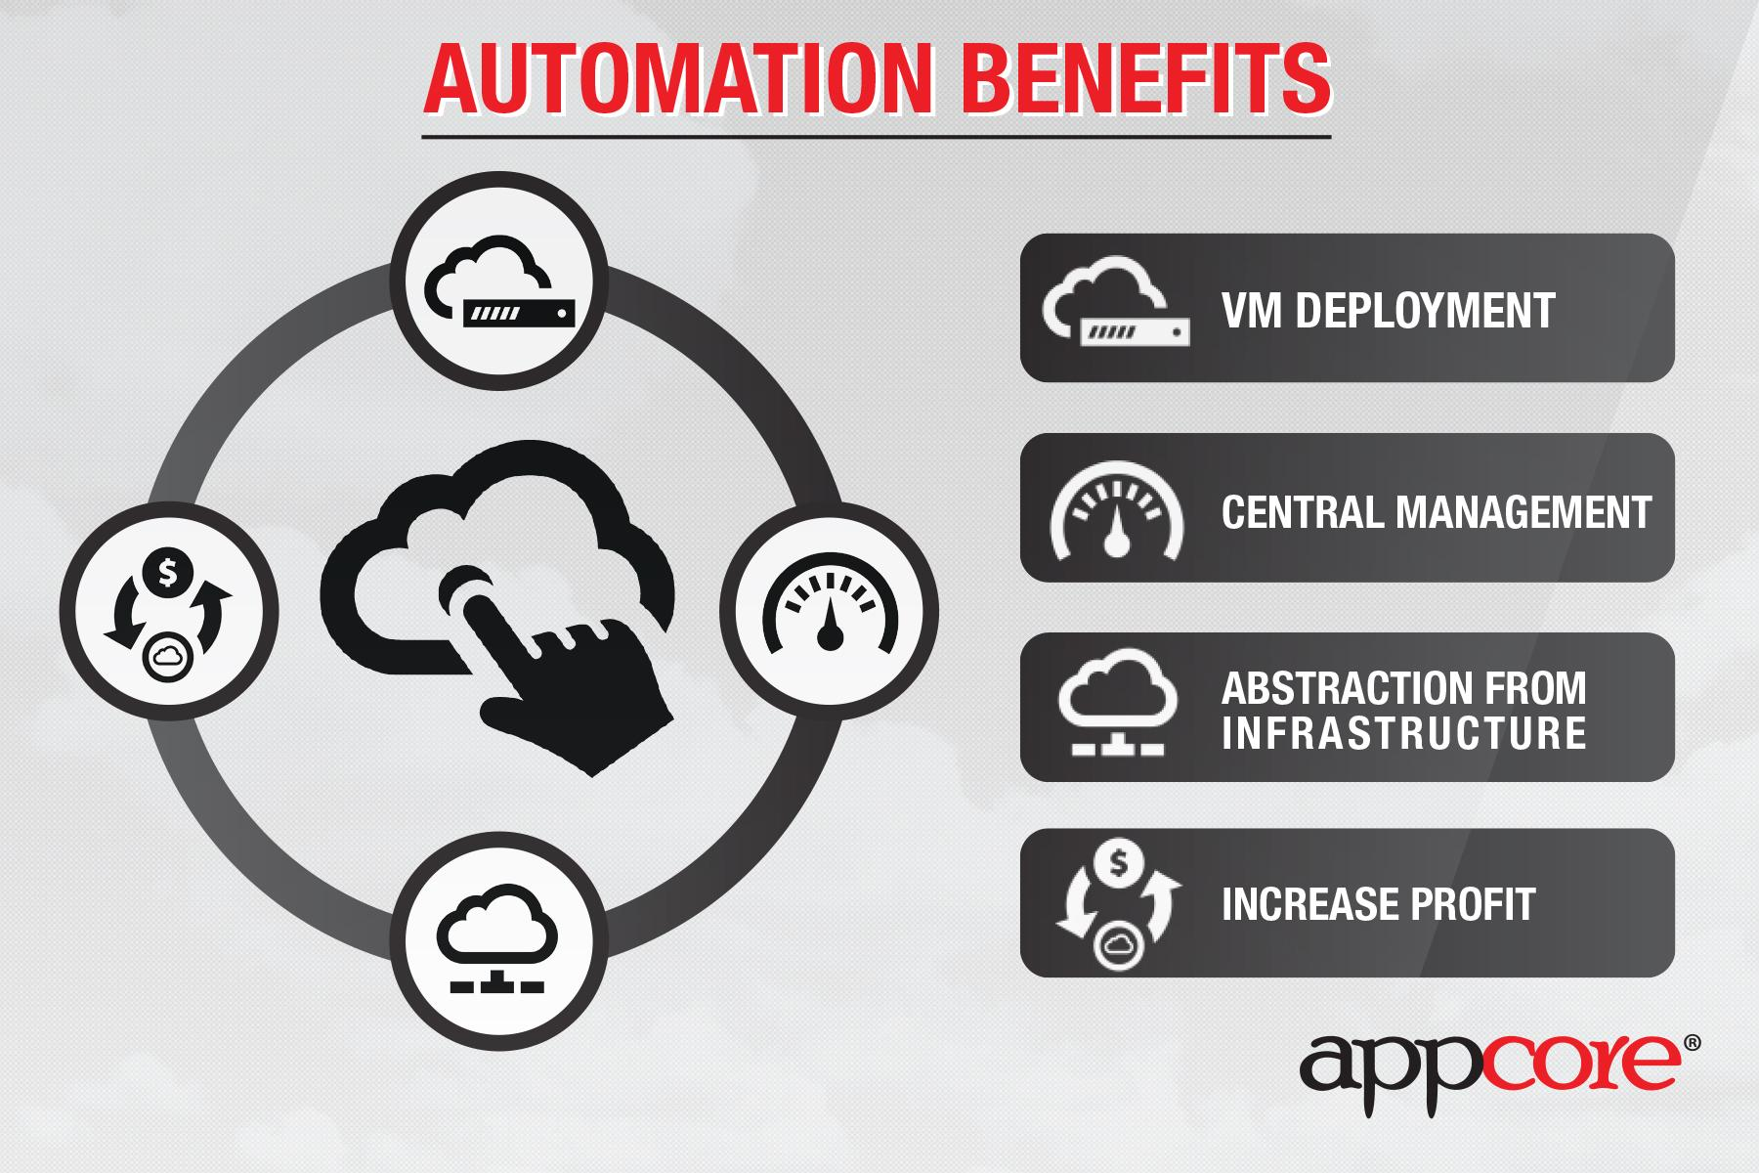
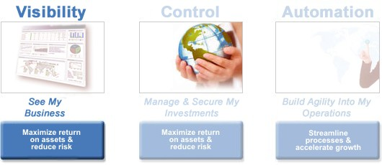
Measured Service - cost factor / benefits :
There are number of reasons why cloud is popular with business:
Cost - do more with less
Automation - reduce labour cost
Service management
system- visibility, control,
automation - one touch approval

Slide 22
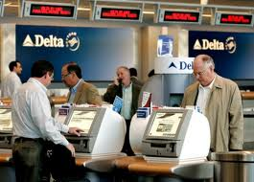
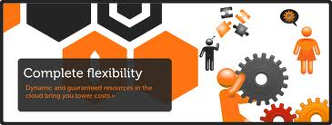
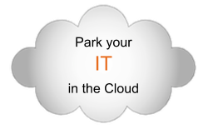
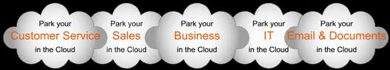
Cost factor -measured service - cntd
Cloud allows self-service
Infrastructure more dynamic =>
lower operational cost,
unlock productivity, better security

Slide 23
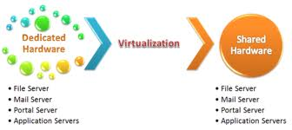
2.3 Cost factor
This results in freeing up budgets, so that financial resources can be used for innovation and development.
Flexibility in accessing of cloud services - without thinking about location and time of execution.

Slide 24
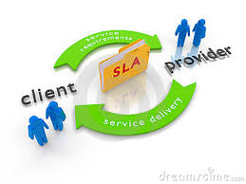


Cost Factor
For secured services, one can put a high level Service Level Agreements (SLA)- to ensure control over its distribution.
In case a company has no R & D team, and want to build one, it is possible to grant resources to them - on demand - when and where they need it, using the dynamic nature of the infrastructure.

Slide 25
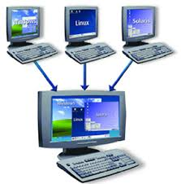
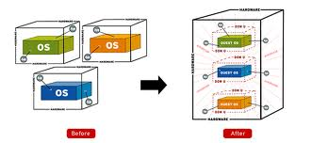
Cost Factor - cntd
Often businesses have hundreds of physical servers and without the application of Virtualization their utilization can be as low as 10%.
Virtualization & Cloud computing increases UTILIZATION and as a consequence reduces capital investments - brings down the cost.

Slide 26
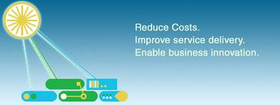
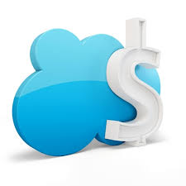
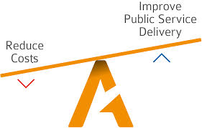
Cost Factor - in brief
The need for cost-saving or optimizing has provided a fertile ground for cloud computing
The cloud computing paradigm is an attempt to improve service delivery by applying engineering discipline and economies of scale in an internet inspired architecture.

Slide 27
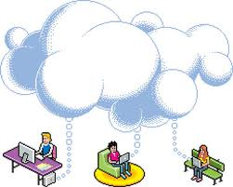
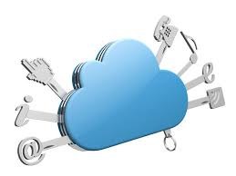
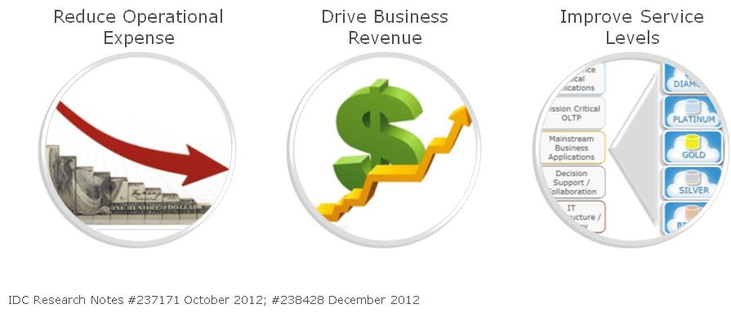
2.3.2 Benefits
Cloud computing when adopted offers the following benefits:
Self-service capability - Web Based
Resource availability - Virtualization
Operational Efficiency - Template approach
Hosted tools

Slide 28

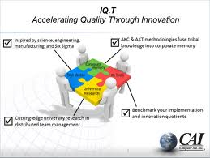
Cumulative Benefits
These benefits help the developers and testers to concentrate on their core-work, leaving the rest to the system.
This increases the quality and productivity, and more developer innovation, increased test quality and coverage..

Slide 29
Cumulative Benefits
One of the reason for testing backlog is that it takes a lot of time to set test and QA environment:
procure new hardware and software
schedule time with IT configuration
Set up the systems
Configuration and setup are manual processes
Poor governance to poor collaboration
Wrongly configured test environments

Slide 30
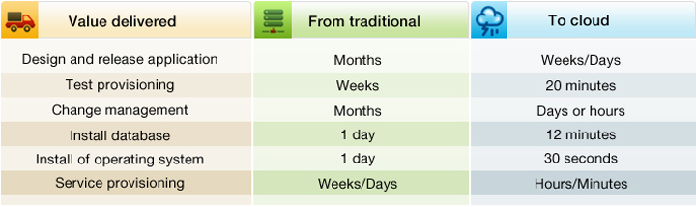
Value of Cloud

Slide 31
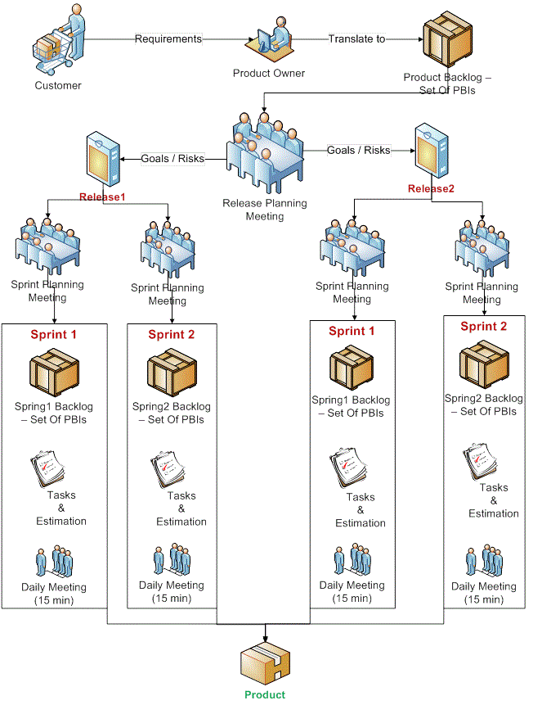
Test environments are seen as expensive and do not provide real business value:

Slide 32
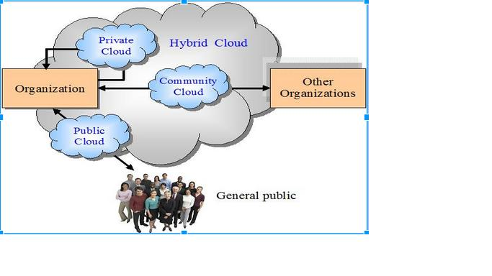
2.4 Cloud Deployment Models
Cloud computing is a style of computing in which business processes, applications, data and any type of IT resources can be provided as a service to users:
Cloud has the following delivery models:
Public
Private
Hybrid
Community

Slide 33
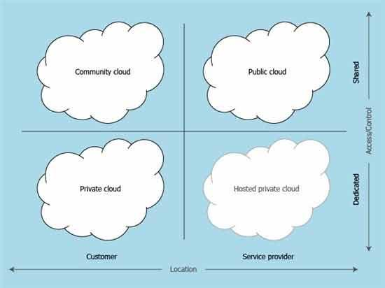

Slide 34
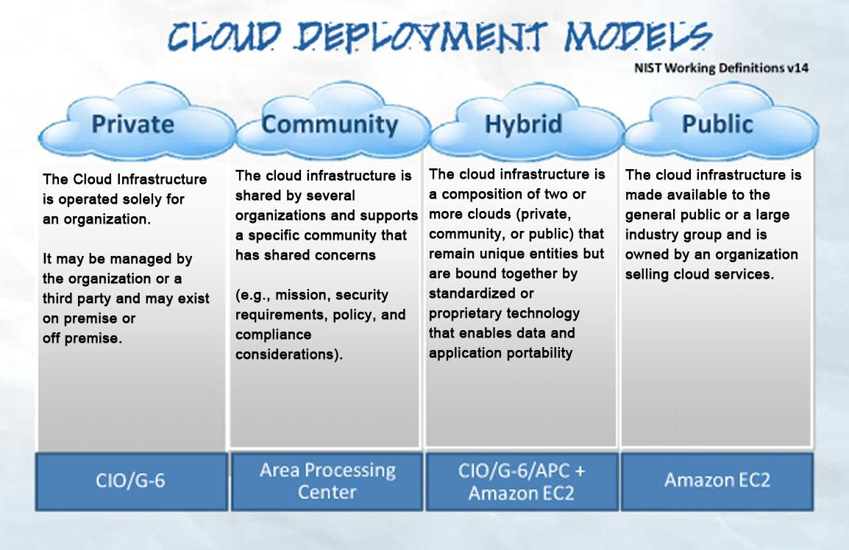

Slide 35

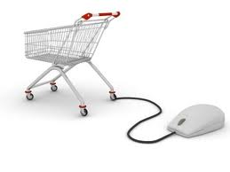
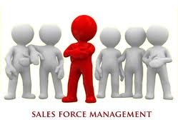
Public Private Hybrid
Public Cloud:
•In public cloud, a business rents the IT capability and they pay for what they use on-demand.
•Public clouds are for processes which can be easily standardized and with a lower security risk.
Ex: e-commerce, sales force management

Slide 36
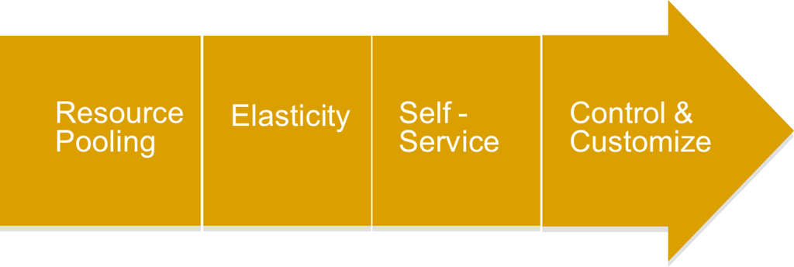
Public Private Hybrid
Private Cloud:
•In private clouds, a business essentially turns its IT environment into a cloud and uses it to deliver services to their users.
•A private cloud drives efficiency while retaining control and greater customization.

Slide 37


Public Private Hybrid
•Hybrid clouds combine elements of public and private cloud.

Slide 38

2.4 Cloud Deployment Models
•There is not a one-size fits-all model.
•Businesses may end up using all these models eventually based on the business model for different services.

Slide 39

2.4.1 Public Clouds
•Public cloud services are available to clients from a third-party service provider via the internet.
•Public clouds provide elastic, cost-effective means to deploy solutions and take care of deploying, managing, and securing the infrastructure.

Slide 40

2.4.1 Public Clouds
•Companies can use Public-Clouds on-demand, and with the pay-as-you-use option, it is much like utility consumption.
•Enterprises are able to offload commodity applications to third party service providers (hosters)

Slide 41



2.4.1 Public Clouds
The term ‘public’ does not mean :
• That it is FREE, even though it can be free or fairly inexpensive to use
• User data is publicly visible-public cloud vendors typically provide an access control mechanism for their users

Slide 42



Public Clouds
Application workloads
–Public facing web pages-
–Public wiki’s, blogs etc
–Batch processing jobs with limited security requirements
–Data intensive workloads
–SaaS applications
–Online storage/backup/restore solutions
–Isolated workloads where latency between application components is not an issue

Slide 43


Slide 44



Application workloads not ready for Public Cloud
•Workloads that depend on sensitive data are normally restricted to the organization
•Most companies are not ready to move their LDAP Lightweight Directory Access Protocol server into a public cloud because of sensitivity of employee information.
•Health care records are also not moved to cloud.

Slide 45



Application workloads not ready for Public Cloud
Workloads that are not suitable for public clouds:
•Workloads composed of multiple, co-dependent services
•High throughput online transaction processing
•Workloads requiring a high level of auditability and accountability

Slide 46

Application workloads not ready for Public Cloud
•Workloads based on third party software that does not have a virtualization or cloud aware licensing strategy
•Workloads requiring detailed chargeback or utilization measurements as required for capacity planning or departmental level billing
•Workloads requiring flexibility and customization

Slide 47


Public Cloud Benefits
•Lower barrier to entry/upfront investment
•Offer self-service for rapid –start development
•Deliver new pricing models for hardware, software and service consumption
•Increase or decrease capacity in minutes
•Pursue new workloads and opportunities demo/sandbox, collaboration and prototypes

Slide 48

2.4.2 Private Clouds
•Private clouds are deployments made inside the company’s firewall or on-premise data centers and run by on-site servers.
•Private clouds offer benefits such as
•elastic on-demand capacity,
•self-service provisioning ,
•service-based access
•Private Clouds provide greater control of cloud infrastructure, improving security, and resiliency because user access and networks used are restricted and designated.

Slide 49


Services in Private Cloud
•Virtualization
•Governance and management
•Multi-tenancy
•Consistent deployment
•Chargeback and pricing
•Security and access control

Slide 50

Consuming services from the public cloud
•Security and data privacy
•Ease of access
•Discovery of services
•RESTful interface support
•Lower cost
•Speed and availability

Slide 51



Private Cloud - High cost of “Privacy”
•Private cloud implementation limits the full realization of cloud computing benefits, including:
•Eliminating capital expenses and operating costs:
•Ownership of the H/W or S/W eliminates the pay-per-use potential, as these must be upfront purchases
•Removing undifferentiated heavy lifting by offloading data center operations

Slide 52

Private Clouds provide more Control

Slide 53


Private Clouds provide more Control
•In traditional security model, location implies ownership, which, in turn implies control when security is location-specific.
•The location, ownership and control are aligned and tightly coupled.
•Need for strong control and security, usually drive a preference for a private cloud – own the resources
•Government may not allow their application,data to be stored outside its geographic borders`

Slide 54

Private Clouds provide more Control
•Clouds rely on virtualization and in the public model, this delinks or decouples location, application and data. This reduces the perceived ownership and control .

Slide 55

•Control of information is NOT dependent on its location or ownership.
–For example, public key encryption allows the holder of key to control the information without owning the rest of infrastructure
–Control can be created over an untrusted infrastructure via a combination of encryption, contracts with service level agreements(SLA) and imposing minimum security standards.

Slide 56

2.4 Cloud Deployment Models
•Control of information is NOT dependent on its location or ownership.
–Compliance is a challenge outside traditional security models
–Public cloud can be made as compliant and secure as possible as private cloud through technology control and contracts.
–Auditing and regulation are continuously adapting to new technologies and business models.

Slide 57

Private Clouds
•There are two extremes to the ownership spectrum
–Complete ownership
–Complete lack of ownership
•There are approaches in-between
–Partial control
–Shared ownership
Levels of limited access- specific departmental access, industry-only access, controlled partner access

Slide 58

2.4.3 Hybrid Clouds
•Hybrid cloud is a combination of an interoperating public and private cloud.
•In this model, users typically outsource non business-critical information and processing to the public cloud and keep business-critical services and data in their control

Slide 59

Hybrid Clouds
•Hybrid cloud provides the best of both cloud worlds
• Scale and convenience of a public cloud and
•Control and reliability of on-premise software and infrastructure and
•Allows free movement between the two

Slide 60

Hybrid cloud allows
–Elasticity - ability to scale capacity up or down in a matter of minutes without owning capital expenses of the hardware or datacenter
–Pay as you go pricing
–Network isolation and secure connectivity as if all the resources were in a privately owned datacenter
–Gradually move to public cloud configuration , replicate an entire data center or move anywhere in between

Slide 61

2.4.4 Community Cloud
•A community cloud is controlled and used by a group of organizations that have shared interest- such as specific security requirements or a common mission.
•The members of the community share access to the data and application in the cloud

Slide 62

2.4.5 Shared Private Cloud
•This is a shared compute capacity with variable usage based pricing to business units that are based on service offerings, accounts datacenters.
•It requires internal profit-center to take over or buy infrastructure made available through account consolidation

Slide 63


2.4.6 Dedicated Private Cloud
Dedicated private cloud has IT services catalog with dynamic provisioning.
It depends on standardized SO architecture assets that can be broadly deployed into new and existing accounts and is a lower cost model.

Slide 64

2.4.7 Dynamic Private Cloud
•Dynamic private cloud allows client workloads to dynamically migrate to and from the compute cloud as needed.
•This model can be shared and dedicated
•It delivers on the ultimate value of cloud.
•This is a very low management model with reliable SLA’s and scalability.

Slide 65

2.4.8 Cloud Models Impact
•Cloud computing will transform the IT industry. They will profoundly affect how we live and how business operate.
•Cloud computing
–Provides massively scalable computing resources from anywhere
–Simplifies service delivery
–Provides rapid innovation
–Provides dynamic platform for
next generation datacenters

Slide 66

Internal Private Clouds – Cost Savings
•Reduce IT Labor by 50% in configuration, operations, management and monitoring
•Improve Utilization by 75%
•Lower administrative cost 50%
•Reduce end-user IT support cost by 40%
•Reduce provisioning cycle from weeks to minutes
•Benefits of cloud economics with security within firewall
•Provide consistency of application environment

Slide 67

2.4.9 Savings and Cost Metrics
•Virtualization leads to consolidation - hence reduces hardware costs
•Labour savings -
•Automation of IT
environment provisioning
further reduces the cost
•Total savings substantially offset the small incremental increase in software costs required for initialization and service management

Slide 68

2.4.10 Commoditization in Cloud
A company needs certain amount of UNIQUE IT to runs its Business ( say Google search infrastructure)
It also needs a huge amount of Commodity IT to run its basic operations.
Cost of commodity IT set up may be high and hence be delegated or outsourced

Slide 69





2.5 Security in a Public Cloud
•Security is a deep concern in Cloud Computing. Here are few security concerns to be considered:
–Multi-Tenancy
–Security Assessment
–Shared Risk
–Staff Security Screening
–Distributed Datacenters
–Physical Security
–Policies
–Coding
–Data Leakage

Slide 70



2.5.1 Multi- Tenancy
•As long as cloud provider builds its security to meet high-risk client, all the lower-risk clients get better security
•Ex: A bandage manufacturer may have a low-risk of being a target of malfeasance.
•A music label that is currently suing file sharers could have a high risk of being targeted by malfeasance
•Hence, Cloud designer must design security to meet the needs of the music label and bandage manufacturer gets the benefit

Slide 71

2.5.2 Security Assessment
•Over time, enterprises tend to relax their security posture.
•To combat a relaxation of security , the cloud provider should perform regular security assessments.
•The assessments should be done by someone who is experienced and able to identify issues and fix them.
•The report should be provided to each client immediately after the assessment is performed so that the clients know the current state of the cloud’s overall security.

Slide 72

2.5.3 Shared Risk
•Often cloud service provider may not be the cloud operator.
–For example, a SaaS provider may use services of an IaaS.
•This may have security implications.
•In this multi-tier service provider arrangement, each provider shares the risk of security.
•The service provider must be aware of cloud architecture used by cloud provider and factor that into overall risk mitigation plan

Slide 73



2.5.4 Staff Security Screening
•Both regular and contract employees must be subjected to all security procedures, background checks etc

Slide 74





2.5.5 Distributed Data Centers
•Disasters include – hurricanes, tornadoes, landslides, earthquakes, and even fiber-cuts
•Geographically distributed data centers provide better data security and disaster management and recovery possibilities

Slide 75


•This includes:
–Card or biometric access
–Mantrap
–Surveillance
–On-site guard
–Escorting the guests
–Automatic Alarms

Slide 76

2.5.7 Policies
Cloud computing companies need to have incident response policies and they need to have procedures for every client that feed into their overall incident response plan

Slide 77


2.5.8 Coding
Every cloud company must follow secure coding practices.
All code must be documented and should be demonstrated to clients.

Slide 78


2.5.9 Data Leakage
•Data leakage is a security risk and challenge.
•At minimum, the data that falls under legislative mandates, or contractual obligation, should be encrypted while in flight and at rest.

Slide 79


Slide 80



2.6 Public versus Private Cloud
•A public cloud is a shared cloud computing infrastructure that anyone can access.
•It provides hardware and virtualization layers that are owned by the vendor and are shared between all customers.
•It is connected to the public internet and presents an illusion of infinitely elastic resource

Slide 81


Slide 82

2.6 Public versus Private Cloud - cntd
•For consumption based pricing, the user pays for resources used, allowing for capacity fluctuations over time.
•Provisioning is applied through simple web interface for self –service provisioning of infrastructure capacity

Slide 83

2.6 Public versus Private Cloud - cntd
•Operating costs for the cloud are absorbed in the usage based pricing.
•Users have no say in SLA or contractual terms and conditions

Slide 84



2.6 Public versus Private Cloud - cntd
•A private cloud is a cloud computing infrastructure owned by a single party.
•It provides hardware and virtualization layers that are owned by, and reserved for the business.
•All data and secure information remains behind the corporate firewall.
•It provides an elastic but finite resource and may not be connected to the public internet
•Private clouds can be designed for specific operating system, applications and use cases, unique to the business.

Slide 85

2.7 Cloud Infrastructure Self-Service
•The cloud infrastructure has to be provisioned and paid-up front in private clouds
•Self-service is possible upto a point.

Slide 86


2.7.1 Infrastructure Strategy and Planning Features
The cloud computing strategy and planning has the following 3 major steps
•Assessment of current environment to determine strengths, gaps and readiness
•Development of the value proposition for cloud computing in the enterprise
•Strategy, planning and roadmaps to successfully implement the selected cloud delivery model

Slide 87


2.7.2 The Path to Cloud Computing
The path from simple virtualization to cloud computing occurs in five distinct stages:
•Stage 1: Server Virtualization - Consolidation attempt
•Stage 2: Distributed Virtualization - Elasticity, Rapidity
•Stage 3: Private Cloud
•Stage 4: Hybrid Cloud
•Stage 5: Public Cloud

Slide 88
2.8 Summary
•Models for cloud computing
•Public
•Private
•Hybrid
•Consistent data availability and security is a critical success factor for any cloud deployment
•Business need to ensure that data is adequately protected and can be restored in a timely fashion following any disruption

Slide 89


Slide 90


